Slide 1
School of Computing Science and Engineering
Course Code: BCSE2350 Course Name: Cryptographic Fundamental
Algebric Structure

Slide 2
Outline
To review the concept of algebraic structures
To define and give some examples of groups
To define and give some examples of rings
To define and give some examples of fields

Slide 3
ALGEBRAIC STRUCTURES
Cryptography requires sets of integers and specific operations that are defined for those sets. The combination of the set and the operations that are applied to the elements of the set is called an algebraic structure. In this chapter, we will define three common algebraic structures: groups, rings, and fields.
Topics discussed in this section:
Groups
Rings
Fields
3

Slide 4
Introduction
of increasing importance in cryptography
AES, Elliptic Curve, IDEA, Public Key
concern operations on “numbers”
where what constitutes a “number” and the type of operations varies considerably
start with concepts of groups, rings, fields from abstract algebra

Slide 5
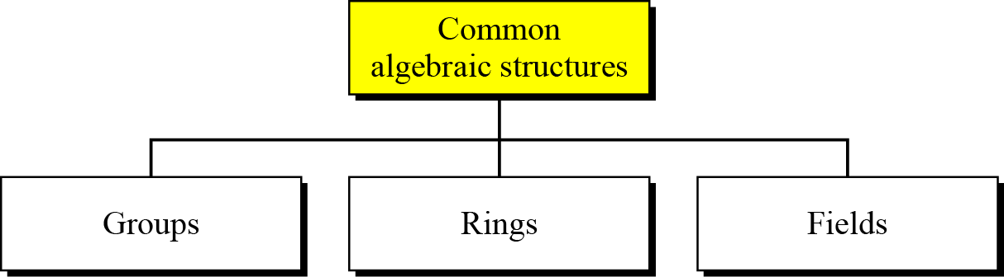

Slide 6
Group: {G, •}
a set of elements or “numbers” with a binary operator “•”.
obeys:
closure: a∈G, b∈G ⇒ a • b ∈ G
associative law: (a • b) • c = a •(b • c)
has identity e: e • a = a • e = a
_{a}-1
has inverses a⁻¹: a = e
if commutative a • b = b • a
then forms an abelian group

Slide 7
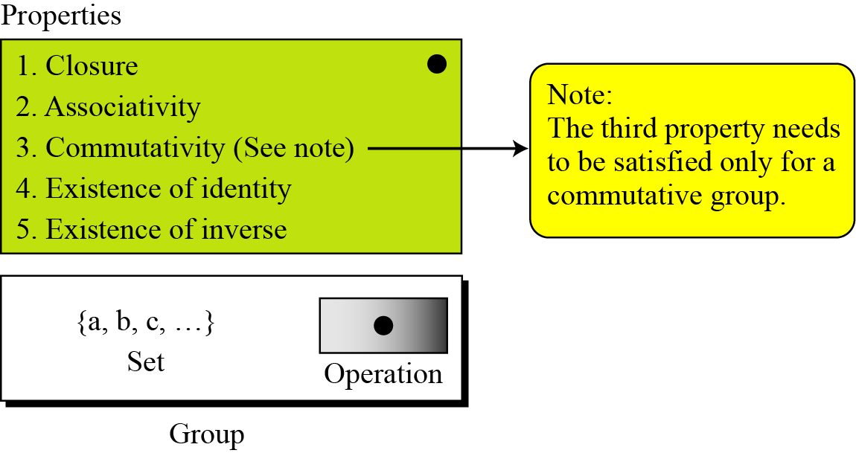
Group: {G, •}

Slide 8
Application
Although a group involves a single operation, the properties imposed on the operation allow the use of a pair of operations as long as they are inverses of each other.
Example
The set of residue integers with the addition operator,
G = < Z_{n} , +>,
is a commutative group. We can perform addition and subtraction on the elements of this set without moving out of the set.

Slide 9
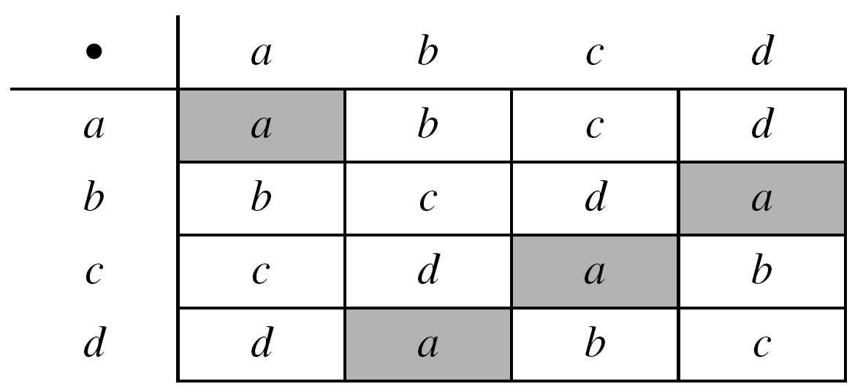
Example
The set Z_{n}* with the multiplication operator, G = <Z_{n}*, ×>, is also an abelian group.
Example
Let us define a set G = < {a, b, c, d}, •> and the operation as shown in Table 4.1.

Slide 10
Cyclic Group
define exponentiation as repeated application of operator
_{a}3
example: = a • a • a
and let identity be: e=a⁰
a group is cyclic if every element is a power of some fixed element a∈G
ie b = a^{k} for some a and every b in group
a is said to be a generator of the group

Slide 11
Ring: {R, +, ×}
a set of “numbers” with two operations (addition and multiplication) which are:
an abelian group with addition operation
multiplication:
has closure
is associative
distributive over addition: a(b+c) = ab + ac
if multiplication operation is commutative, it forms a
commutative ring (ab = ba).. a,b ∈ R
if multiplication operation has multiplicative identity and no zero divisors, it forms an integral domain

Slide 12
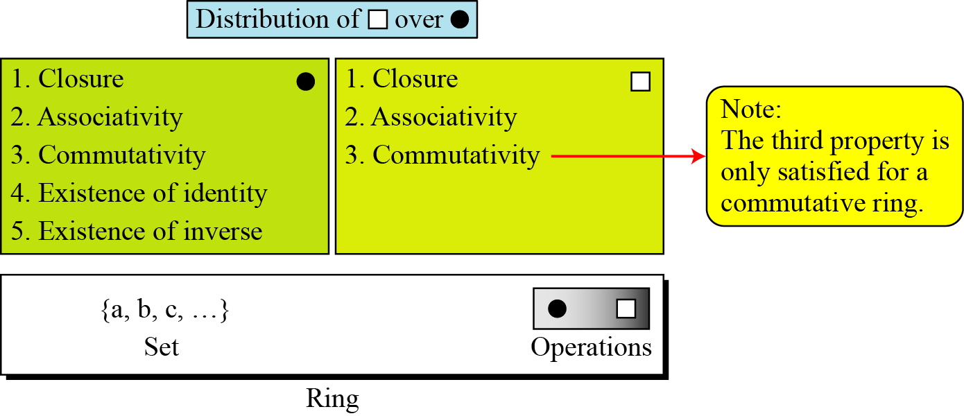
A ring, R = <{…}, •, >, is an algebraic structure with two operations.

Slide 13
The set Z with two operations, addition and multiplication, is a commutative ring. We show it by R = <Z, +, ×>. Addition satisfies all of the five properties; multiplication satisfies only three properties.

Slide 14
Field {F, +, ×}
a set of numbers with two operations:
abelian group for addition
abelian group for multiplication (ignoring 0)
Ring
obeys:
has multiplicative inverses a⁻¹:
_{a}-1
a = e

Slide 15
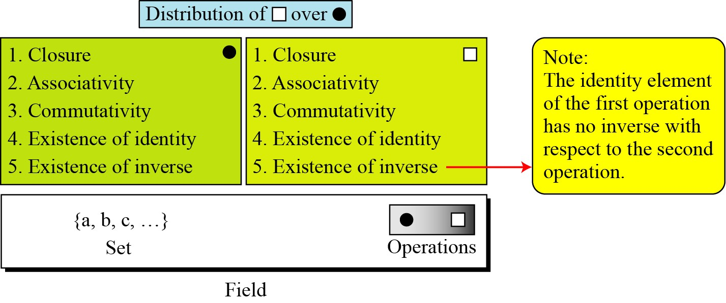
A field, denoted by F = <{…}, •, > is a commutative ring in which the second operation satisfies all five properties defined for the first operation except that the identity of the first operation has no inverse.
5

Slide 16

Finite Fields
Galois showed that for a field to be finite, the number of elements should be p^{n}, where p is a prime and n is a positive integer.
Note
A Galois field, GF(p^{n}), is a finite field with p^{n} elements.

Slide 17
4.1.3 Continued
GF(p) Fields
When n = 1, we have GF(p) field. This field can be the set Z_{p}, {0, 1, …, p − 1}, with two arithmetic operations.

Slide 18


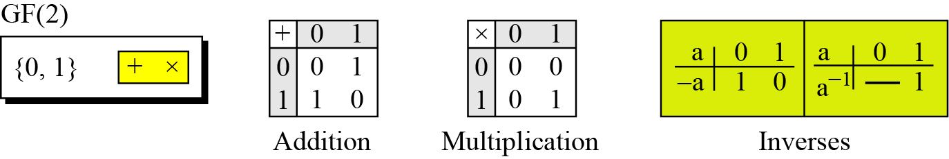
4.1.2 Continued
Example 4.12
A very common field in this category is GF(2) with the set {0, 1} and two operations, addition and multiplication, as shown in Figure 4.6.
Figure 4.6 GF(2) field

Slide 19
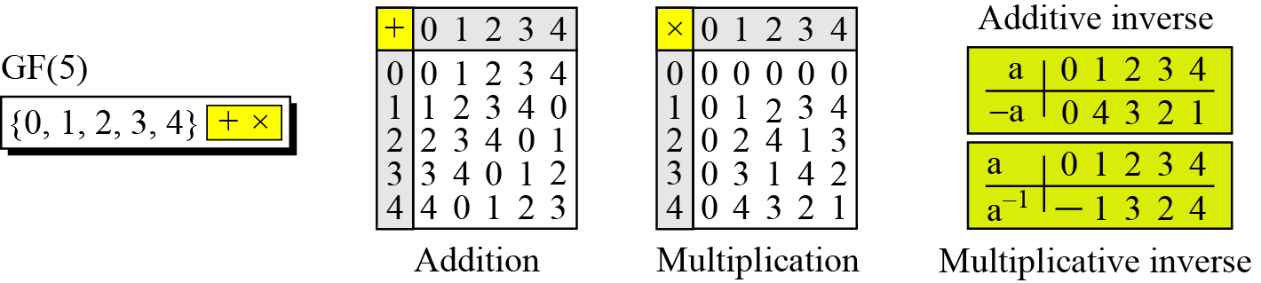
4.1.2 Continued
Example 4.13
We can define GF(5) on the set Z₅ (5 is a prime) with addition and multiplication operators as shown in Figure 4.7.
Figure 4.7 GF(5) field

Slide 20
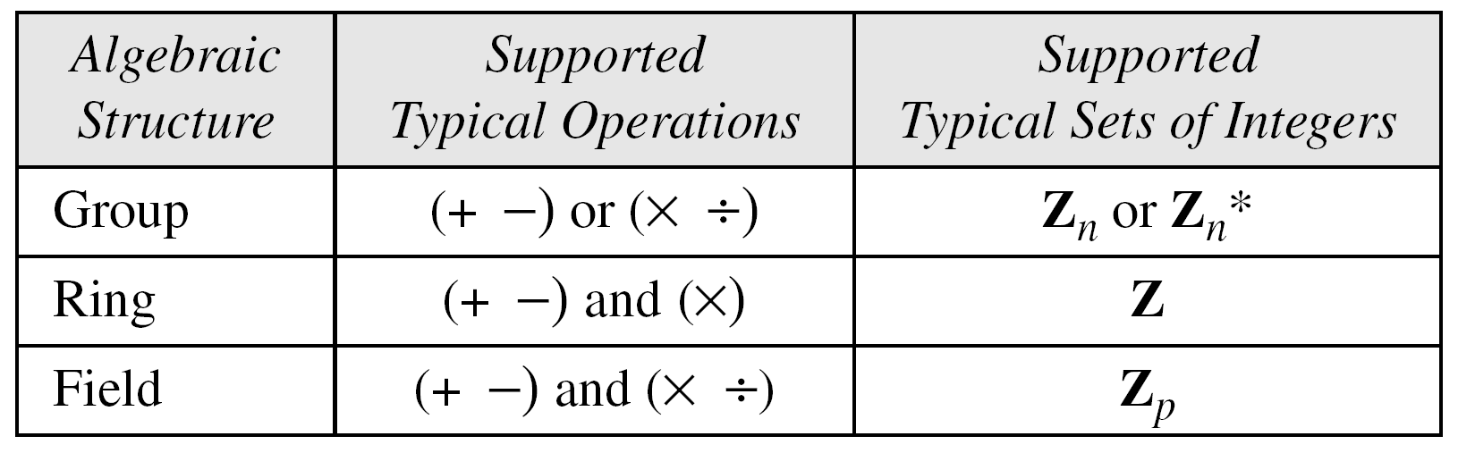
4.1.3 Continued
Summary
Table 4.3
Summary

Slide 21
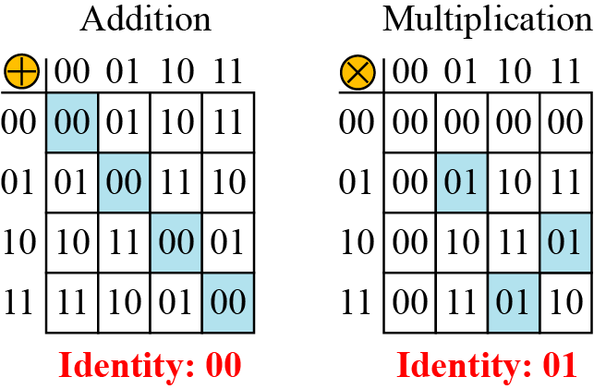
4.2 Continued
Example 4.14
Let us define a GF(2²) field in which the set has four 2-bit words:
{00, 01, 10, 11}. We can redefine addition and multiplication for this field in such a way that all properties of these operations are satisfied, as shown in Figure 4.8.
Figure 4.8 An example of GF(2²) field
---V-VIIJAYJAY KKATTA-ATTA---

Slide 22
4.2.1 Continued
GF(2^{n}) Fields
Note
Polynomials representing n-bit words use two fields: GF(2) and GF(2^{n}).

